Slide 1

System Development
Databases, MS SQL Server and SQL
Dr Simon Scola

Slide 2
Guide to these Slide
There is a lot of material:
  Some of it is core material,
  Some of it is background information,
  Some of it is reference information
Reference and/or background information is marked as blue slides
White slides represent the core lecture material
Background information
Core information

Slide 3
‘What is a database?

Slide 4
Background information
Personnel
Payroll
View
View
Corporate
Database

Slide 5
Background information
Personnel
Payroll
Forms
and Reports
Forms
and Reports
View
View
query
query
Corporate
Database
EMP_NO | FirstName | LastName | TITLE | WAGE
1 | Simon | Scola | Senior Lecturer | 10,000
2 | Miltos | Petridis | Principal Lecturer | 12,000

Slide 6
Background information
Personnel
Payroll
Example views
Forms
and Reports
Forms
and Reports
View
View
EMP_NO | NAME | TITLE
1 | Simon Blake | Senior Lecturer
2 | Miltos Petridis | Principal Lecturer
EMP_NO | NAME | WAGE
1 | Simon Blake | 10,000
2 | Miltos Petridis | 12,000
query
query
Corporate
Database
EMP_NO | FirstName | LastName | TITLE | WAGE
1 | Simon | Scola | Senior Lecturer | 10,000
2 | Miltos | Petridis | Principal Lecturer | 12,000

Slide 7
A typical database may contain
Tables
Queries
Stored procedures
Forms
Users
And much more besides...

Slide 8
A Quick SUMMARY of DB, ERD and normalisation
  The basic concepts that are essential:
    Tables
    Fields
    Records
    Primary keys
    Foreign keys
    Relationships

Slide 9
Tables
also known as base tables
contain data as records (aka rows, tuples)
  Where a record consists of fields (aka attributes)
records are not stored sorted or grouped
should be a minimal data set
based on Entity Relationship Model

Slide 10
Tables
Customer Table
Customer#
FirstName
LastName
EMail
1
Simon
Blake
bs66@gre.ac.uk
2
Alex
Fedorec
fa08@gre.ac.uk
10001
Peter
Smith
sp04@gre.ac.uk
A table contains: Fields and Records.
  Synonymous terms: At table contains: Attributes and Rows

Slide 11
Records contain FIELDS
FIELDS
Customer#
FirstName
LastName
EMail
1
Simon
Blake
bs66@gre.ac.uk
2
Alex
Fedorec
fa08@gre.ac.uk
10001
Peter
Smith
sp04@gre.ac.uk
Fields have various data types
The fields define the data that can be stored in a record
Every record/row has the same fields/attributes within a table

Slide 12
Tables contain RECORDS
Customer#
FirstName
LastName
EMail
RECORDS
1
Simon
Blake
bs66@gre.ac.uk
2
Alex
Fedorec
fa08@gre.ac.uk
10001
Peter
Smith
sp04@gre.ac.uk
Record are a set of data fields within a table.
A table can have many records.
In this example our table has 3 records
Synonyms, rows, tuple, records

Slide 13
Records accessed via KEYs
PRIMARY KEY
Customer#
FirstName
LastName
EMail
1
Simon
Blake
bs66@gre.ac.uk
2
Alex
Fedorec
fa08@gre.ac.uk
…
…
…
…
10001
Peter
Smith
sp04@gre.ac.uk
etc
etc
etc
etc
A primary key uniquely identifies a record in a table. It should be UNIQUE and thus it should NOT BE DUPLICATED
PKs often depicted with a HASH #, underlined as a prefix PK or a suffix PK
NOTE: It depends on the notation you choose to use

Slide 14
PRIMARY KEYs
DATA THAT IS DEPENDANT UPON THE PRIMARY KEY
Customer#
FirstName
LastName
EMail
1
Simon
Blake
bs66@gre.ac.uk
2
Alex
Fedorec
fa08@gre.ac.uk
…
…
…
…
10001
Peter
Smith
sp04@gre.ac.uk
etc
etc
etc
etc
Fields ‘Simon’, ‘Blake’, ‘Bs66@gre.ac.uk’ are all dependant upon the primary key (Customer#)
Thus, given a ‘Customer#’ we can find their FirstName, LastName and Email
FUNCTIONAL DEPENDENCY was covered in your normalisation lecture

Slide 15
PRIMARY KEYs
DATA THAT IS DEPENDANT UPON THE PRIMARY KEY
Customer#
FirstName
LastName
EMail
1
Simon
Blake
bs66@gre.ac.uk
2
Alex
Fedorec
fa08@gre.ac.uk
…
…
…
…
10001
Peter
Smith
sp04@gre.ac.uk
etc
etc
etc
etc
Given Key ‘1’ we can determine the field data as ‘Simon’, ‘Blake’, etc.
And key ‘1’ does not refer to anyone else, its unique
UNIQUENESS
NON-DUPLICATED

Slide 16
Relationships
CustomerTable
Customer#
FirstName
LastName
EMail
1
Simon
Blake
bs66@gre.ac.uk
2
Alex
Fedorec
fa08@gre.ac.uk
3
Chaoying
Ma
mc@gre.ac.uk
10001
Peter
Smith
sp04@gre.ac.uk
etc
etc
etc
etc
OrderTable
Order#
Customer#
Date
TotalCost
1
1
12/12/2004
65423
2
1
11/10/2005
1235
3
3
11/10/2005
12235
10001
2
12/10/2005
5468
etc
etc
etc
etc
PRIMARY KEY
FOREIGN KEY

Slide 17
Relationships
Primary Key is a unique identifier of records
  To find dependant information within the order table
The Foreign key is used to RELATE tables
  In this example to find associated information in the Customer table
OrderTable
Order#
Customer#
Date
TotalCost
1
1
12/12/2004
65423
2
1
11/10/2005
1235
…
…
…
…
10001
2
12/10/2005
5468
etc
etc
etc
etc
PRIMARY KEY
FOREIGN KEY

Slide 18
Relationships
CustomerTable
Customer#
FirstName
LastName
EMail
1
Simon
Blake
bs66@gre.ac.uk
2
Alex
Fedorec
fa08@gre.ac.uk
??
NO RELATED RECORD, You can enforce a constraint, that requires a related record
!
OrderTable
Order#
Customer#
Date
TotalCost
1
1
12/12/2004
65423
2
1
11/10/2005
1235
3
4
12/10/2005
5468
Enforcement of this constraint is called REFERENTIAL INTEGRITY
That the references between tables are correct (a synonym for the word integrity is the word correct) So referential integrity simply means the ‘correctness’ of our references, i.e. the integrity of our foreign key references.

Slide 19
CustomerTable
Customer#
FirstName
LastName
EMail
1
Simon
Blake
bs66@gre.ac.uk
2
Alex
Fedorec
fa08@gre.ac.uk
4
Peter
Smith
sp04@gre.ac.uk
Now we have a related record – Now we satisfy REFERENTIAL INTEGRITY constraints
OrderTable
Order#
Customer#
Date
TotalCost
1
1
12/12/2004
65423
2
1
11/10/2005
1235
3
4
12/10/2005
5468

Slide 20
Which/what is a primary key?
Which/what is a foreign key?
More questions?
A unique identifier of a record in a table. Used to find an exact record from a table.
An attribute in a table that is a primary key from another table. The foreign key is used to reference data in the other table (i.e. used for relationships), e.g. Customer# below.
Order table
Order# Customer# Date
1 1000 12/12/08
2 1001 12/1/09
3 1000 12/12/05

Slide 21
SQL

Slide 22
SQL: The Name
SQL - pronounced, officially,
  as the letters ‘S-Q-L’, or as ‘See-Quel’.
SQL- an abbreviation for Structured Query Language.
What does “structured” here mean? – only due to a feature called nested queries, or sub-queries.
Something of a misleading name as its is not just a query language.

Slide 23
SQL: History
1974 – SEQUEL (Structure English Query Language), by D. Chamberlin, also by IBM.
1976 – SEQUEL/2, a revised version. The name was changed to SQL for legal reason.
1987 – the initial ISO standard for SQL was published – it was defined actually in 1983.
1992 – the first major revision to the ISO standard occurred SQL2 (SQL-92).
1999- formalised standard released, commonly referred as SQL-99, supporting object-oriented data management.
2003 – a further release, SQL:2003.
Today – there are literally hundreds of SQL-based products available.

Slide 24
SQL: Advantages
SQL is the first and most widely accepted standard database language – Almost every major databases support SQL.
SQL is easy to learn – The statements are made up of a small set of descriptive English words.
SQL is very powerful – complex and sophisticated operations can be performed by cleverly using the simple language elements.

Slide 25
SQL: Components
DDL – Data Definition Language statements are used to create, modify, and delete tables, columns, keys, and integrity rules.
DML – Data Manipulation Language statements are used to add, change, retrieve, and delete data in the tables and to define and delete views.
DCL - Data Control Language statements grant and revoke authorisation privileges to and from users.
We are going to do a quick of the first two

Slide 26
SQL: Dialects from different vendors
Each implementation of SQL is called a dialect.
No two dialects are exactly alike.
Currently, no dialect exactly matches the ISO standard.
Transact-SQL (Transact SQL, also called T-SQL, is Microsoft's extension to the ANSI SQL language. It is the driving force of Microsoft's SQL Server and is a dynamic database programming language.)
PL/SQL (Programming Language/SQL (PL/SQL) is an Oracle extension of the SQL statement set which allows the developer to impose flow control and logic design onto unstructured SQL command blocks. PL/SQL also implements basic exception handling.)
PL/pgSQL (PL/pgSQL is a loadable, procedural language, similar to the Oracle procedural language, PL/SQL. A procedural language is a programming language used to specify a sequence of steps that are followed to produce an intended programmatic result.)
MS Server
MY SQL
Oracle
Access
Postgres

Slide 27
Microsoft SQL Server
MS SQL Server
We will use MS SQL Server for your introduction
Why? Because:
It has a nice GUI environment
It’s a enterprise scale database
Its easier for beginners than Oracle or PostgreSQL
It's not MS Access (MS Access is a poor database
Its FREE for students

Slide 28
MS SQL Server Tools

Slide 29
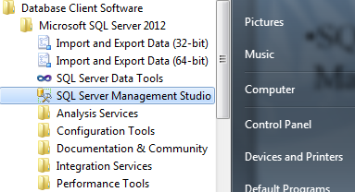
Installation at Greenwich
Database Client Software
Microsoft SQL Server 20012
SQL Server Management Studio

Slide 30
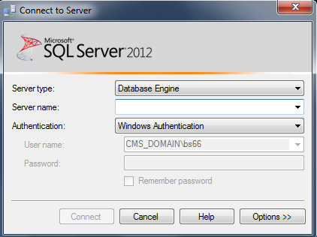
Installation at Greenwich
You should use the server name called:
SQL-Server
Guide available on teachmat:
http://labs.cms.gre.ac.uk/db/managementstudio.asp

Slide 31
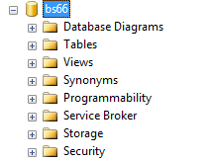
SQL: Data Types
You each have a DB area
In your DB area you have lots of folders which you can use to create:
  Tables
  Views
  Triggers
  Stored Procedures
  Diagrams
  Etc.

Slide 32
A list of Database Objects in SQL Server
Reference
Reference
The database itself
The transaction log
Tables
Filegroups
Diagrams
Views
Stored procedures
User defined functions
Users
Roles
Defaults
User-defined data types
Full-text catalogs
………..

Slide 33
Reference
SQL server Database Objects
The Database Object
The database is effectively the highest-level object that one can refer to within a given SQL Server.
When you first load SQL Server, you begin with the following 6 databases installed:
  master
  userID
  msdb
  Northwind
  PDC
  student
  tempdb

Slide 34
Reference
SQL server Database Objects
The Transaction Log
While the data is read in and from the database file, and changes you make don’t initially go to the database itself – instead, they are written serially to the transaction log.
At some later point in time, the database is issued a checkpoint – it is at that point in time that all the changes in the log are propagated to the actual database file.

Slide 35
Reference
SQL server Database Objects
Tables
Databases are made up of many things, but none are more central to the make-up of a database than tables.
  name, column, row, data type, primary/foreign key, …
  Indexes
  Triggers
  Constraints

Slide 36
Reference
SQL server Database Objects
Diagrams
  A database diagram is a visual representation of the database design, including the various tables, the columns in each table, and the relationships between tables.

Slide 37
Reference
SQL server Database Objects
Views
A view is a ‘virtual’ table.
A view, for the most part, is used just like a table, except that it doesn’t contain any data itself.
A view is merely a pre-planned mapping and representation of the data stored in tables.

Slide 38
Reference
SQL server Database Objects
Stored Procedures
Stored procedures are an ordered series of Transact-SQL statements bundled up into a single logic unit.
Stored procedures allow for variables and parameters as well as selection and looping constructs.

Slide 39
Reference
SQL server Database Objects
User defined functions
UDFs have a tremendous number of similarities to Stored procedures, except that they:
  Can return a value of most SQL Server data types, excluding text, ntext, image, cursor and timestamp.
  Can’t have “side effect” . Basically, UDFs can’t do anything that changes outside the scope of the functions, such as changing tables, sending e-mails, or system or database parameter changes.

Slide 40
Reference
SQL server Database Objects
Users and Roles
  These two go hand in hand.
    Users are pretty much the equivalent to logins. An user represents an identifier for someone to login into the SQL Server. Anyone logging into SQL Server has a map to a user.
    Users belong to one or more roles. Rights to perform certain actions in SQL Server can then be granted either directly to a user or to a role to which that one or more users belong.

Slide 41
Reference
SQL server Database Objects
Rules
  Rules and constraints provide restriction information on what can go into a table. If an updated or inserted record violates a rule, then that update or insertion will be rejected.
  A rule can be used to define a restriction on a user-defined data type.
  Unlike rules, constraints are not really objects unto themselves, but rather pieces of meta data describing a particular table.

Slide 42
Reference
SQL server Database Objects
User-Defined Data Types
  User-defined data types are extensions to the system-defined data types.
  One can take a system-defined data type, such as integer, and bind a rule to it (e.g., the value for the integer must be greater than 5000).
  User-defined data types are limited in scope to just the database in which they are created.

Slide 43
Reference
SQL server Database Objects
Full-text Catalogs
  Full-text catalogs are mappings of data that speed the search for specific blocks of text within columns that have had full-text searching enabled.

Slide 44
Reference
SQL Comments
ANSI SQL standard
  The characters -- (two hyphens) indicate that the reminder of the current line is a comment.
The extension
  The pairs of characters /* and */ mark the enclosed text as a comment.

Slide 45
Basic SQL
DDL – Data Definition Language statements are used to create, modify, and delete tables, columns, keys, and integrity rules.
Used to specify / define our databases structure
    CREATE TABLE Customer (
  CustomerID INT NOT NULL,
  LastName VARCHAR(255),
  FirstName VARCHAR(255),
  Address VARCHAR(255),
  City VARCHAR(255)
    );

Slide 46
SQL: Data Types
Data type definition
An attribute that specifies what type of information can be stored in a column, parameter, or variable.
System-supplied data types are provided by SQL Server;
User-defined data types can also be created by means of deriving from base data types.
Examples,
  Numeric data types
  String data types
  Data types for date and/or time
  Other data types

Slide 47
SQL: Data Types
  Numeric data types
    INT
    BIGINT
    SMALLINT
    TINYINT
    DECIMAL
    NUMERIC
    FLOAT
    REAL
    MONEY
    SMALLMONEY
  String data types
    CHAR
    VARCHAR
    TEXT
    NCHAR
    NVARCHAR
    NTEXT
    BINARY
    VARBINARY
    BIT
    IMAGE
  Other data types
    CURSOR
    SQL_VARIANT
    TABLETIMESTAMP
    UNIQUEIDENTIFIER
    SYSNAME

Slide 48
SQL: Numeric Data Types
Reference
Transact-SQL uses the following numeric data types are used to represent numbers:
  INT (or INTEGER): Integer data from -2^31 through 2^31 – 1 (4 bytes).
  BIGINT: Integer data from -2^63 through 2^63 – 1 (8 bytes).
  SMALLINT: Integer data from -2^15 through 2^15 – 1 (2 bytes).
  TINYINT: Non-negative data from 0 through 2^7 – 1 (1 bytes).

Slide 49
SQL: Numeric Data Types
  DEC(p,[s]) (or DECIMAL): Fixed precision and scale numeric data from -10^38 +1 through 10^38 –1. Precision p specifies the total number of digits with assumed decimal points s (scale) digits from the right. E.g., DECIAML(8,2).
  NUMERIC([,]): Functionally equivalent to DECIMAL.
  FLOAT[(p)]: Floating precision number data from -1.79E + 308 through 1.79E + 308.
  REAL: Floating precision number data from -3.40E + 38 through 3.40E + 38.

Slide 50
SQL: Numeric Data Types
  MONEY
    Monetary data values from -2^63 through 2^63 – 1 (8 bytes),
    with accuracy to a ten-thousandth of a monetary unit.
  SMALLMONEY
    Monetary data values from -214,748.3648 through +214,748.3647 (4 bytes),
    with accuracy to a ten-thousandth of a monetary unit.

Slide 51
SQL: String Data Types
Transact-SQL uses three string data types: character strings, binary strings, and bit strings.
  CHAR[(n)]: Fixed-length non-Unicode character data with a maximum length of 8,000 characters. The default length is 1. If a string entered is with fewer characters than the specified length, the string is padded with blanks on the right to make up the required size. Each CHAR character is stored in 1 byte. E.g., CHAR(3).
  VARCHAR[(n)]: Variable-length non-Unicode data with a maximum of 8,000 characters. Each VARCHAR character is stored in 1 byte. E.g., VARCHAR(30).
  TEXT[(n)]: Variable-length non-Unicode data with a maximum length of 2^31 - 1 characters. Each TEXT character is stored in 1 byte.

Slide 52
SQL: String Data Types
  NCHAR[(n)]: Fixed-length Unicode data with a maximum length of 4,000 characters. Each NCHAR character is stored in 2 bytes.
  NVARCHAR[(n)]: Variable-length Unicode data with a maximum length of 4,000 characters. Each NVARCHAR character is stored in 2 bytes. sysname is a system-supplied user-defined data type that is functionally equivalent to nvarchar(128) and is used to reference database object names.
  NTEXT[(n)]: Variable-length Unicode data with a maximum length of 2^30 - 1 characters. Each NTEXT character is stored in 2 bytes.

Slide 53
SQL: String Data Types
  BIANRY([n]): Fixed-length binary data with a maximum length of 8,000 bytes.
  VARBINAY([n]): Variable-length binary data with a maximum length of 8,000 bytes.
  IMAGE([n]): Variable-length binary data with a maximum length of 2^31 - 1 (2,147,483,647) bytes.
  BIT: Integer data with either a 1 or 0 value.

Slide 54
SQL: Data Types for Date/Time
  DATETIME: Date and time data from January 1, 1753, through December 31, 9999, with an accuracy of three-hundredths of a second, or 3.33 milliseconds.
  SMALLDATETIME: Date and time data from January 1, 1900, through June 6, 2079, with an accuracy of one minute.
Format: “dd mmm yyyy” (e.g., ’10 Jan 1993’, or “10 Jan 1993”).

Slide 55
SQL: Other Data Types
CURSOR: A reference to a cursor.
SQL_VARIANT: A data type that stores values of various SQL Server-supported data types, except TEXT, NTEXT, TIMESTAMP, and SQL_VARIANT.
TABLE: A special data type used to store a result set for later processing .
TIMESTAMP: A database-wide unique number that gets updated every time a row is inserted or updated.
UNIQUEIDENTIFIER: A globally unique identifier (GUID).
SYSNAME: Specifies the name of database objects in the system catalog (defined as NVARCHAR(128)).

Slide 56
Data Definition Language
  Data Definition Language (DDL) statements are used to define the database structure or schema.
  Some examples:
    CREATE - to create objects in the database
    ALTER - alters the structure of the database
    DROP - delete objects from the database
    TRUNCATE - remove all records from a table, including all spaces allocated for the records are removed
    COMMENT - add comments to the data dictionary
    RENAME - rename an object

Slide 57
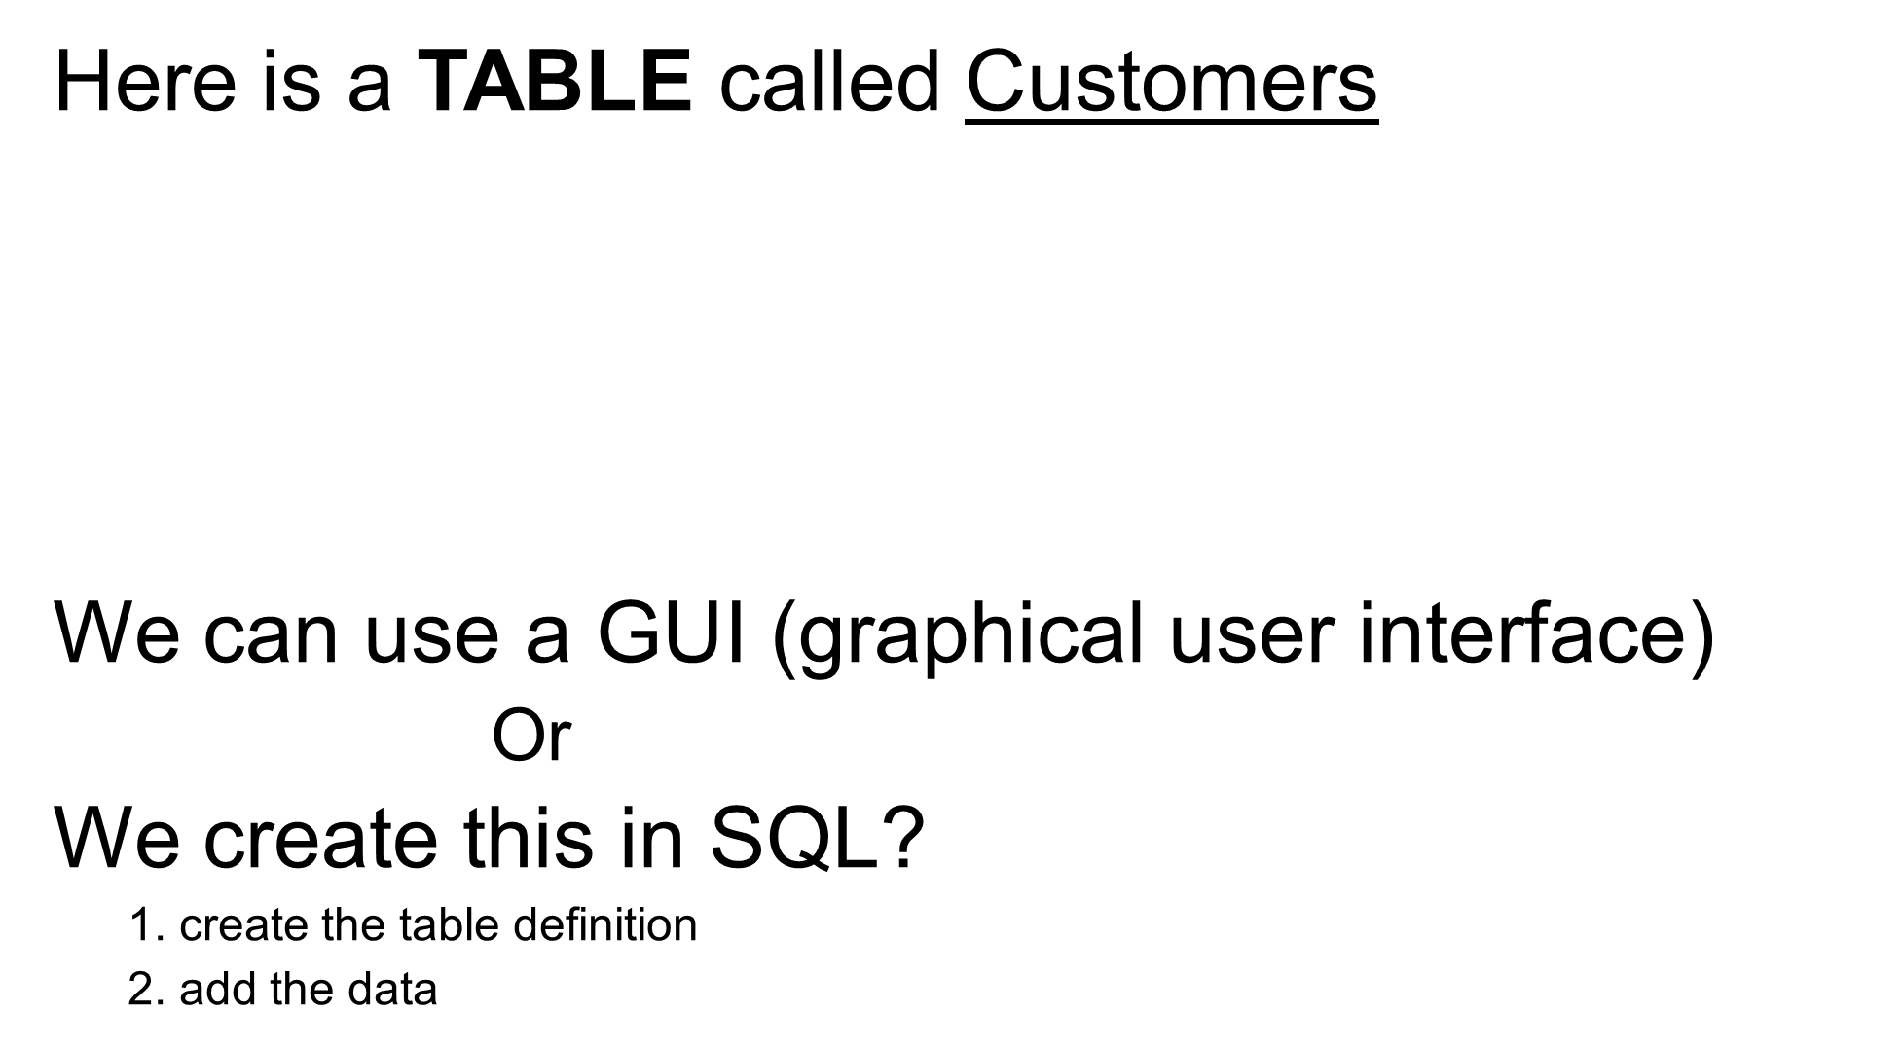
Using CMS MS SQL Server
CustomerID | LastName | FirstName | Address | City
1 | Blake | Simon | 56 Park Row | London
2 | Scola | Simon | 11 Greenwich high street | London
3 | Ma | Chaoying | 22 Maple Drive | Cambridge

Slide 58
Data Definition Language (DDL)
General form
An example instance
    CREATE TABLE <table name> (
    <name> <datatype>,
    <name> <datatype>,
    <name> <datatype>,
    <name> <datatype>,
    Etc.. Etc..
    );
    CREATE TABLE Customer (
  CustomerID INT NOT NULL,
  LastName VARCHAR(255),
  FirstName VARCHAR(255),
  Address VARCHAR(255),
  City VARCHAR(255)
    );

Slide 59
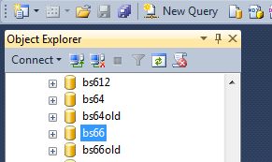
How do you run SQL in SQL Server
Select you database user area
Right hand click and select ‘New Query’

Slide 60
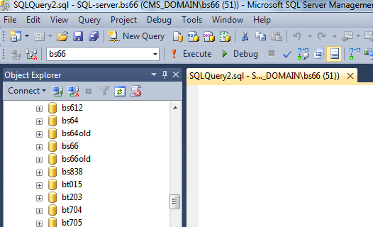
How do you run SQL in SQL Server
This then opens a SQL pane into which you can write your SQL code

Slide 61
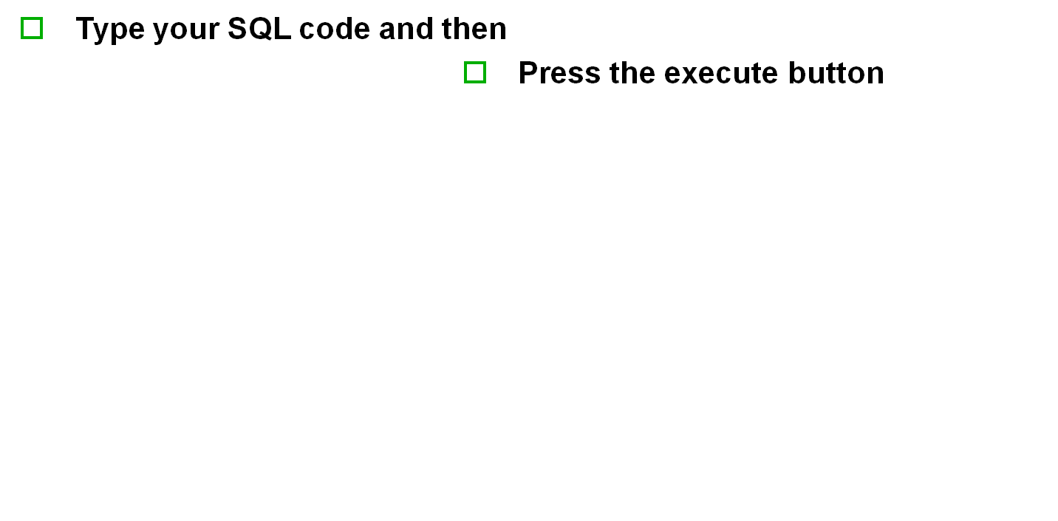
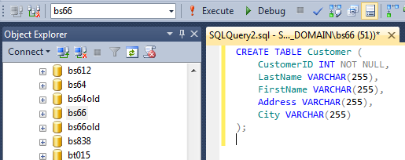
How do you run SQL in SQL Server

Slide 62
The TABLE definition creates an empty table structure.
Now we need to add some data
    This uses the Data Manipulation Language from SQL
  1. create the table definition
  2. add the data
CustomerID | LastName | FirstName | Address | City

Slide 63
DML: Inserting data
Two methods of using the INSERT
1. The first form doesn't specify the column names where the data will be inserted, only their values, i.e.
  INSERT INTO table_name VALUES (value1, value2, value3,...)
2. A second form specifies both the column names and the values to be inserted:
  INSERT INTO table_name (column1, column2, column3,...) VALUES (value1, value2, value3,...)
Method 2 Maps value1 into column1, value2 into column2 etc.

Slide 64
Inserting data (method 1)
General form
An example instance
    INSERT INTO <table name> VALUES ( <data>, <data>, …
    );
INSERT INTO Customer VALUES ( 1,'Blake', 'Simon', '56 Park Row', 'London');
Note:
Text is specified in single quotes, e.g. ‘text’
Numeric data is specified without quotes
Some other rules exists too for other datatypes

Slide 65
DML: Inserting data (Method 2)
INSERT INTO Customer (CustomerID, LastName, FirstName, Address) VALUES
( 2,'Scola', 'Simon', '11 Greenwich high street') ;

Slide 66
DML: Retrieving Data
The SQL SELECT Statement
□The SELECT statement is used to select data from a database.
  □
SQL SELECT Syntax examples:
SELECT column_name(s) FROM table_name or
SELECT * FROM table_name

Slide 67
DML: Retrieving Data
Query the Customer Table
  Select * from Customer;
  /* selects all columns – the entire table */
  Select LastName, FirstName from Customer;
  /* selects ONLY LastName and FirstName */
  Select FirstName + ' ' + LastName as Name from Customer;
  /* selects FirstName and LastName and concatenates them together adding a blank space and then storing the result in an alias called Name*/
  Aliases (used to rename things or when creating new things on the fly)
  FirstName as FName

Slide 68
We now have the following created!
Congratulations class, we just learnt how to create the following.
Or did we??
CustomerID | LastName | FirstName | Address | City
1 | Blake | Simon | 56 Park Row | London
2 | Scola | Simon | 11 Greenwich high street | London
3 | Ma | Chaoying | 22 Maple Drive | Cambridge

Slide 69
DDL: Altering tables
Add a primary key column from the Customer Table
  ALTER TABLE Customer ADD CONSTRAINT pk_Customer PRIMARY KEY (CID)
  /* Alters the table Customer to add a PK constraint*/
  SELECT * FROM Customer;
  /* display the new table */

Slide 70
DDL: Altering tables
Altering is useful for adding new fields, deleting fields, changing datatypes, adding constraints, etc.
BUT! You must be careful that your alterations do not invalidate existing data.

Slide 71
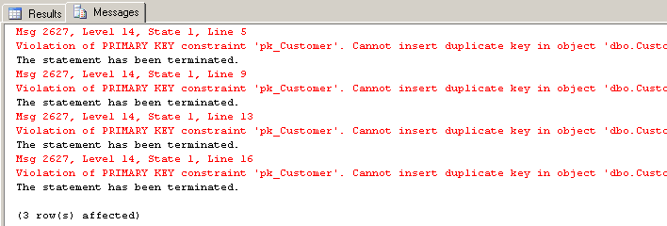
Altering tables
Try to add some illegal data
  INSERT INTO Customer (CID, LastName, FirstName, Address)
  VALUES ( 3, 'Dan', 'Senior', '122 Maple Drive ');
  /* try to add some data that breaches the pkconstraint */

Slide 72
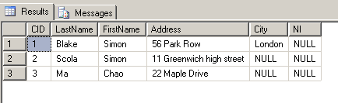
Altering tables
Adding a Field to the Customer Table
  ALTER TABLE Customer ADD NI VARCHAR(10);
  /* adds a national insurance number called NI */
  SELECT * FROM Customer;
  /* display the new table */

Slide 73
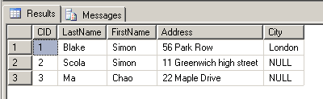
Altering tables
Removing a column from the Customer Table
  ALTER TABLE Customer DROP COLUMN NI;
  /* removes the national insurance number field */
  SELECT * FROM Customer;
  /* display the new table */

Slide 74
Deleting a table
Deletes a table and its data
Uses the keyword, DROP
  DROP TABLE Customer ;
  /* removes the table */
  /* removes the data in the table */

Slide 75
Re-create with Auto increment PK
Recreates specifying the PK as an IDENTITY (auto increment field)
  CREATE TABLE Customer (
  CustomerID INT PRIMARY KEY IDENTITY,
  LastName VARCHAR(255),
  FirstName VARCHAR(255),
  Address VARCHAR(255),
  City VARCHAR(255)
  );
  /* creates table; */
Designates CID as PRIMARY KEY IDENTITY
The word INDENTITY defines the auto increment

Slide 76
Re-create with Auto increment PK
Add some more data BUT without specifying the auto-increment values
  INSERT INTO Customer ( LastName, FirstName, Address, City)
  VALUES ('Blake', 'Simon', '56 Park Row', 'London'
  ) ;
  INSERT INTO Customer ( LastName, FirstName, Address, City)
  VALUES ('Scola', 'Simon', '11 Greenwich high street', 'London'
  ) ;
  INSERT INTO Customer (LastName, FirstName, Address, City)
  VALUES ('Ma', 'Chaoying', '22 Maple Drive ', Cambridge');
  /* Add three records using auto increment; */

Slide 77
Re-create with Auto increment PK
Add some more data BUT without specifying the auto-increment values
  INSERT INTO Customer ( LastName, FirstName, Address, City)
  VALUES (‘Dench', ‘Peter', '516 Heath Row', 'London'
  ) ;
  INSERT INTO Customer ( LastName, FirstName, Address, City)
  VALUES (‘Dan', ‘Tairo', '141 Greenwich low street', 'London'
  ) ;
  /* Add two records using auto increment; */

Slide 78
Summary
Database basics
SQL Server
SQL data definition language
SQL data manipulation language
Shown the following SQL keywords
    CREATE
    INSERT
    SELECT
    ALTER
    DROP
Now go practice!

Slide 79
Bibliography
Database Systems – A Practical Approach to Design, Implementation, and Management, 4th Ed., by Thomas Connolly and Carolyn Begg, Pearson Education Limited, 2005.
Professional SQL Server 2000 Programming, by Robert Vieira, Wiley Publishing, Inc., 2003.
SQL Server 7 – A beginner’s Guide, by Dusan Petkovic, McGraw-Hill, 1999.
BooksOnLine
SQL in a nutshell (o’reilly)
Prof SQL Server 2000 programming (WROX)
http://www.sql.org
http://www.microsoft.com/sql/default.asp
http://www.artofprogramming.net/development/dev_sqlserver.html
http://www.asp101.com
http://www.15seconds.com

Slide 80
END

